Slide 1
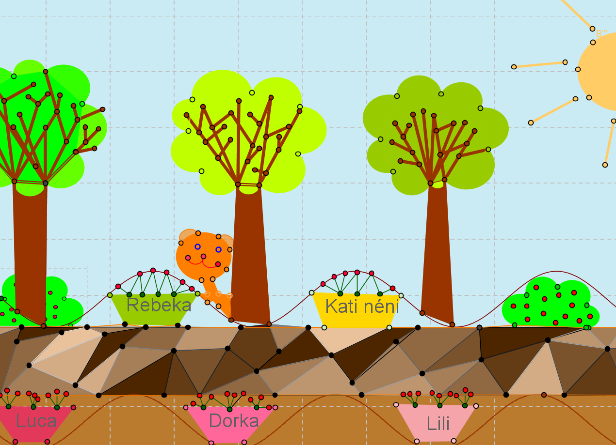
Geomatech competition
Stettner Eleonóra
Kaposvár University
VI. Cadgme, Marosvásárhely
September 07-10, 2016

Slide 2
National competitions for Hungarians living in and outside Hungary.
Three groups cames from outside Hungary, one from Transylvania, from Csíkszereda, and two from the Ukraine, from Ungvár and Gyula.
We prepared tasks for six different age groups, between 6 and 18 year - old students. There were competition rounds for 9 months, and each round had a central topic. Groups of 1 – 5 persons could participate in the competition.

Slide 3
Problems that the compilers of the tasks had to solve:
We had to set tasks which gave work to think about and to create enough for one month for the whole group.
The tasks had to allow everybody to join in, not only the best mathematicians, but they had to contain enough challenge for the best ones, too.
The tasks had to be new and interesting so that students feel the urge to enter.
The use of GeoGebra had to be essential to the solution of the tasks. (It was the most difficult to achieve in the case of lower primary school pupils.)

Slide 4
Impossible
Or not?
These images were constructed by Euler3D.
Thanks to Szilassi Lajos and Petró Tamás

Slide 5
 | Number of registered groups in the 9 round | Number of active groups | Number of children participating in the active groups
1st and 2nd class students | 23 | 13 | 42
3rd and 4th class students | 36 | 29 | 98
5th and 6th class students | 98 | 66 | 222
7th and 8th class students | 57 | 32 | 117
9th and 10th class students | 50 | 25 | 85
11th and 12th class students | 38 | 15 | 52
All | 303 | 180 | 616

Slide 6
The rounds and theirs central topics
Round 1 -- April 2014
The motto of the month: Let’s discover the colourful world of GeoGebra during creation!
This month you will get playful, creative tasks. The most important will be to browse the options of GeoGebra very thoroughly while you are planning and drawing together.
In this round our aim was not to tie the children’s hands with a particular task: Let them look at all icons and menus: let them browse among the options of GeoGebra.
Round 2 -- May 2014
The motto of the month: The pleasure of discovery, problem solving, thinking
After the playful drawing tasks of the first round, in this one all age groups got a mathematical task. We looked for mathematical tasks which are difficult to solve in a traditional way and are challenging for the particular age group, but experimenting with GG they can get an idea which leads to the solution of the problem, and it may also help in the formulation of the explanation.

Slide 7
Round 3 – June 2014
The motto of the month: Curiosity and research on the Internet
This month the students were given research tasks on the Internet which were closely connected with a task which can be solved with GG.
Round 4 -- December 2014
Playful creation with GG
For the new groups it’s a chance to get to know the opportunities of GG, and also for the old ones it’s a playful, relaxed round. The topics are: Father Christmas, Christmas tree, decorations and postcards, winter landscape with Father Christmas, presents, etc.
Round5 -- January 2015
All age groups solved a spatial task with the help of GG 3D
Round 6 – February 2015
Let’s become financial advisers with the help of GG! From budgeting the pocket money to successful investments. Let’s analyse and plan our money matters consciously. Let’s not fall for deceidful, glittering false offers.

Slide 8
Round 7 – March 2015
Certain, impossible, how probable? Adventures in the realm of randomness
Round 8 – April 2015
Two-person games in GG, strategies of games theory
Round 9 – May 2015
Let’s experiment, measure, then calculate and analyse with GG!
In some rounds the children’s task was not to solve a traditional mathematical problem; instead they could create freely using the tool system of GeoGebra. During the solution of these creative tasks the participants mobilized much deeper mathematical knowledge than they would have done with a traditional mathematical problem.
Seeing the children’s solutions we can realize how many interactive possibilities GeoGebra contains for the illustration of the connection between mathematics and arts.

Slide 9
Diary
It was new in second round that we asked the upper primary school and the grammar school students to keep a diary. Looking back it proved to be very useful idea, although it wasn’t easy for the children to formulate the explanation and the discussion. But on the one hand it was useful because this way they are getting used to write down their thoughts, and on the other hand we received a lot of useful comments in connection with the competition and with GG. Moreover, from the diaries we can see that while understanding and solving the tasks, the children had to cooperate, argue, communicate and help each other.
We asked the chronicle from the children the following way:
Choose a chronicler of you! A member of the team should describe how the task solving process happened. For example: „First A suggested that ... we tried, but it was not successful, then we tried the following solution according to a proposal from B ... etc." Write down your opinion, which task’s solution was easy, which was difficult and why? Which task was interesting, novel, boring, difficult, etc. Did you have any ideas that you wanted to do with GeoGebra, but you failed?

Slide 10
Some quotations from the diaries show that children are willing to do hard and serious work and to make an effort nowadays, too.
’We were thinking an awful lot about the tasks, but we solved them with a lot of time and hard work. ’ 5th and 6th class group
’Task A was done so that after some dozens mistaken attempts we finally understood it.’ 5th and 6th class group
’At the beginning of task two we were trying randomly, and then we succeeded by sitting down and thinking about it for an hour.’ 7th and 8th class group
Also some theachers wrote their opinion, I quote from one of them
About teamwork (A teacher says)
During solving GG competition tasks children can experience team spirit. At the beginning of GG extra classes children worked individually on their own computers. Teamwork on the competition tasks also involved the parents. They welcomed the group and were willing to provide a warm and friendly place with pleasure. They assist to the sensible and profitable use of the computer at home. One of the groups built the original construction based on the plans, with their childhood building blocks and they went on solving the task step by step this way. It’s a pleasure to look at these photos: they listen to each other, they pay attention to each other’s ideas, you can almost hear their thoughts.

Slide 11
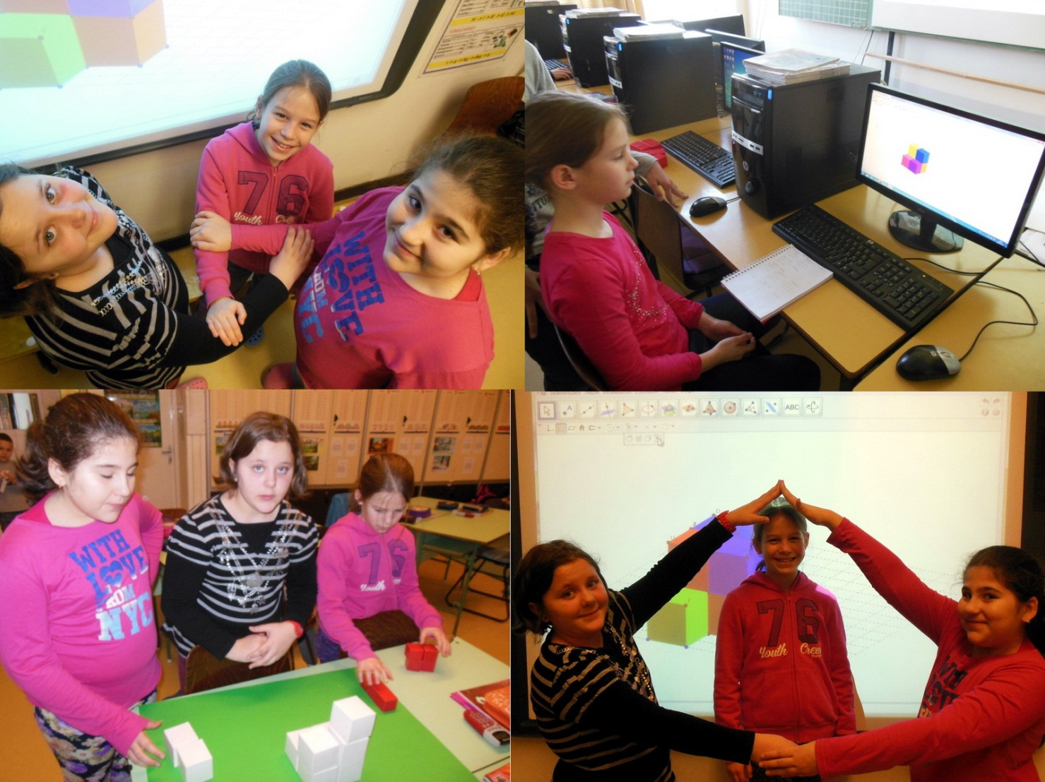
11

Slide 12
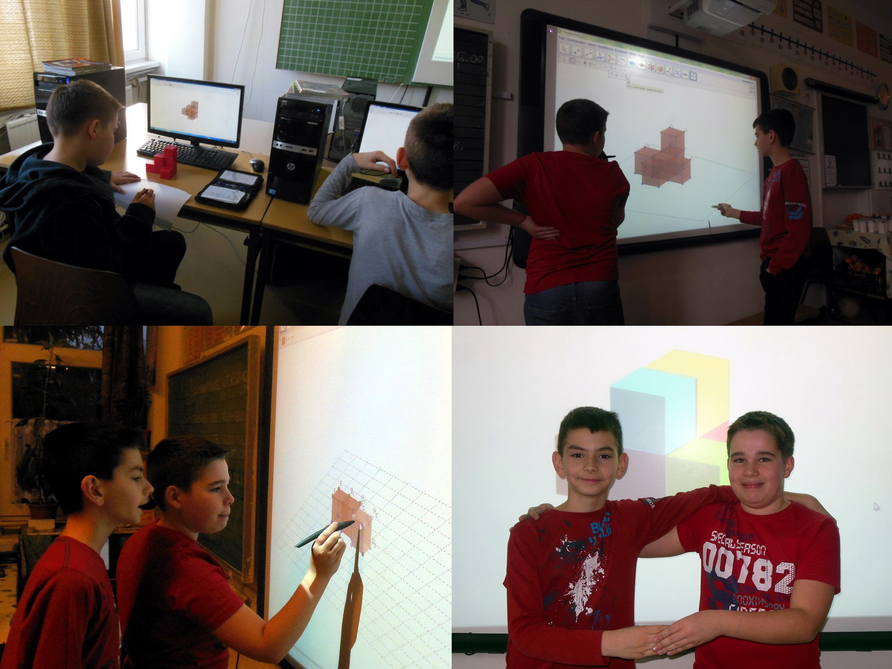

Slide 13
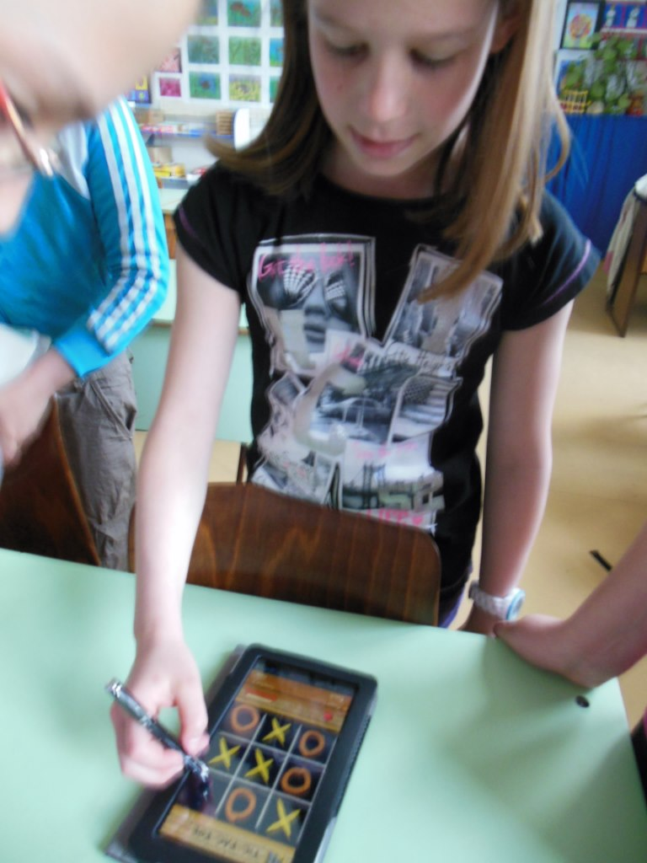
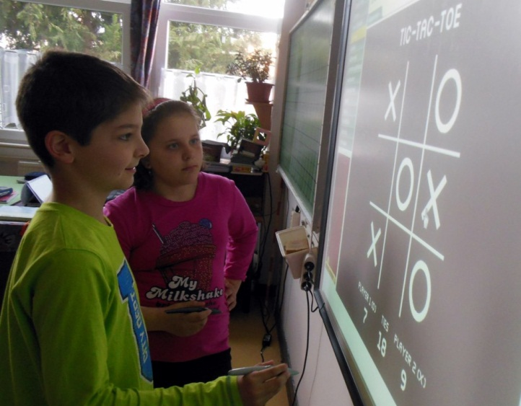
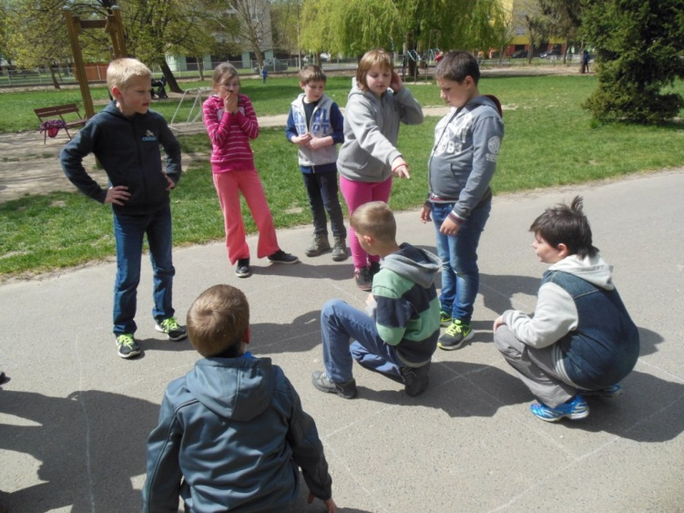
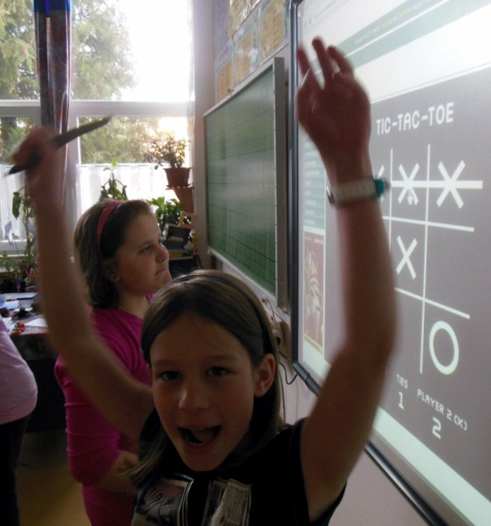
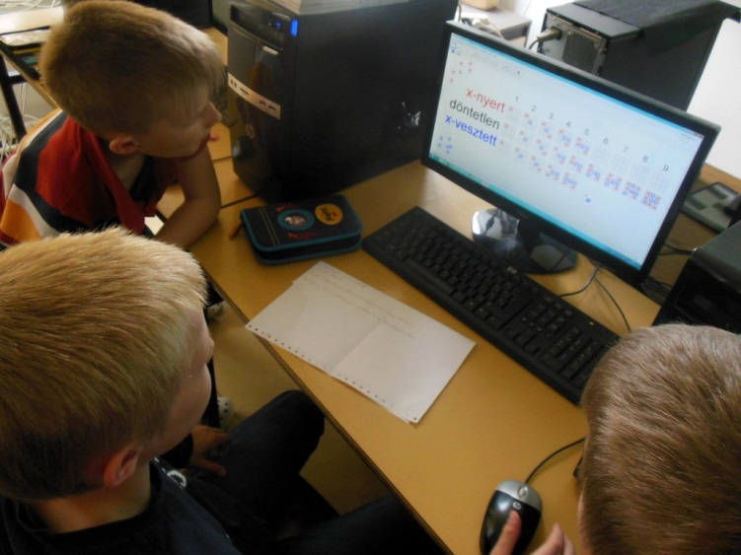

Slide 14
Some interesting tasks and ingenious solutions
Round 1
The task of lower primary school students are connected to Easter. During drawing use as many geometrical shapes (circle, triangle, square, etc.). Colour the drawing and use different linestyles.
1st and 2nd class students:
Illustrate what patterns you imagine for the Easter egg decoration. Paint wonderful shapes, design interesting and colourful patterns with GeoGebra.
3rd and 4th class students:
What kind of Easter postcard would you like to send? Design with GeoGebra what kind of Easter postcard would you send to your family and friends.

Slide 15
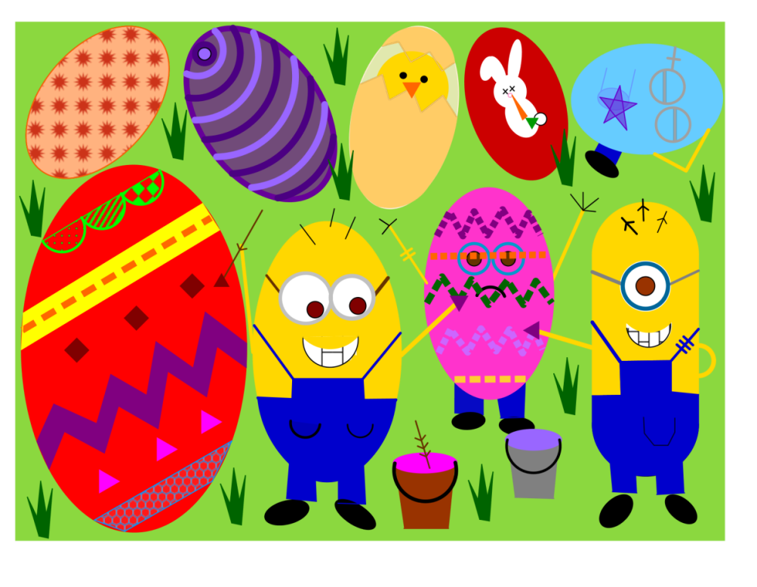
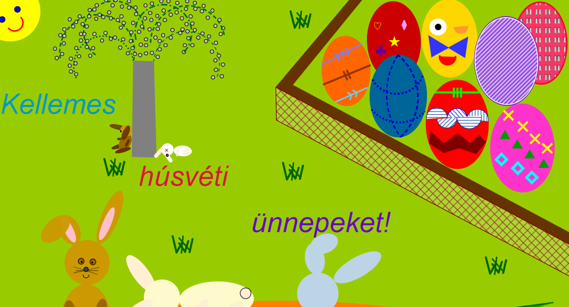
15

Slide 16
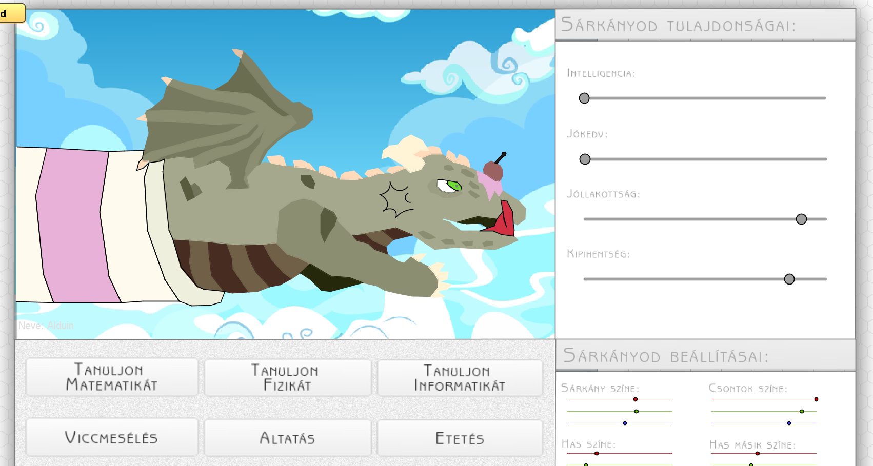
Tasks for secondary school students-- round1
Imagine working in a advertising design studio. During design use as many dynamic opportunities of GG as you can (e.g. colours, slider, check box, button, input box and there should also be connections among the shapes)
9th and 10th class students
Think of an exciting computer game and design its cover with GG. The cover should be so interesting, active and challanging that everybody would like to play with it.
NatusVincereHEXAPHIX_9_10apr.ggb

Slide 17
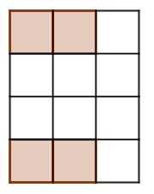
We composed a playful, fabular text for lower primary school children.
In this round we are visiting to Squareland. The ground plan of the houses and gardens are squares, or can be set out using squares. Four siblings inherited the site that can be seen in the drawing, the coloured squares denote the houses (four houses are in the drawing).
Help them divide the site into same sized and same shaped parts so that exactly one house can be placed to each site. Draw the figure in GeoGebra and then draw with colour pencil the fences. (Turn the grid on the drawing sheet to help.)
Change the task, place the four houses to other places on the same area, then do the division. Search possible and not possible solutions.
Draw the tasks in GeoGebra, you can send the comments belonging to the solution in a text file or you can write it into the GeoGebra files.

Slide 18
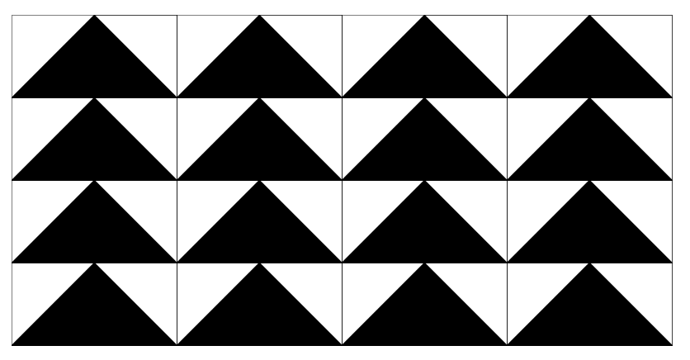
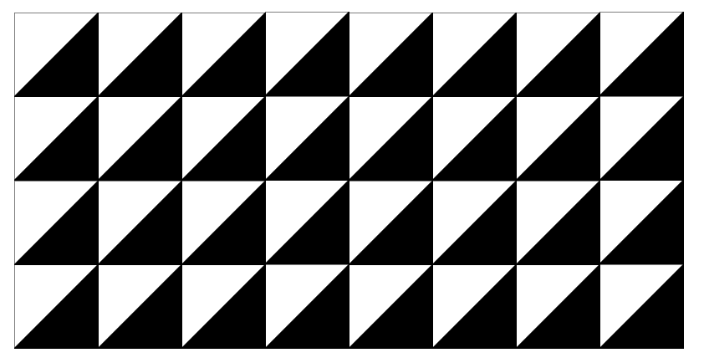
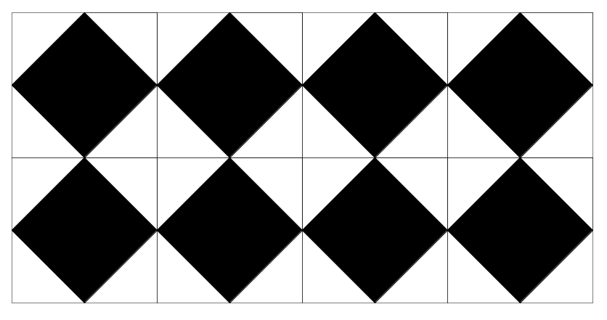
Square Simon is moving into one of the houses. They would like to cover three rooms of their flat with square shaped tiles. Simon has bought only one type of tiles, but a lot of it.
Design him a figured, coloured tile, which he can lay out in multiple patterns if he pastes them in different ways. So his flat won’t be boring.
Show him the tiling of each room, lay down enough tiles for Simon to understand how to continue it. If a beautiful tile is ready, do the tiling with the help of copying and mirroring!
We’ll show an example. A square-shaped tile can be seen below and next to it three possible patterns made of this tile.

Slide 20
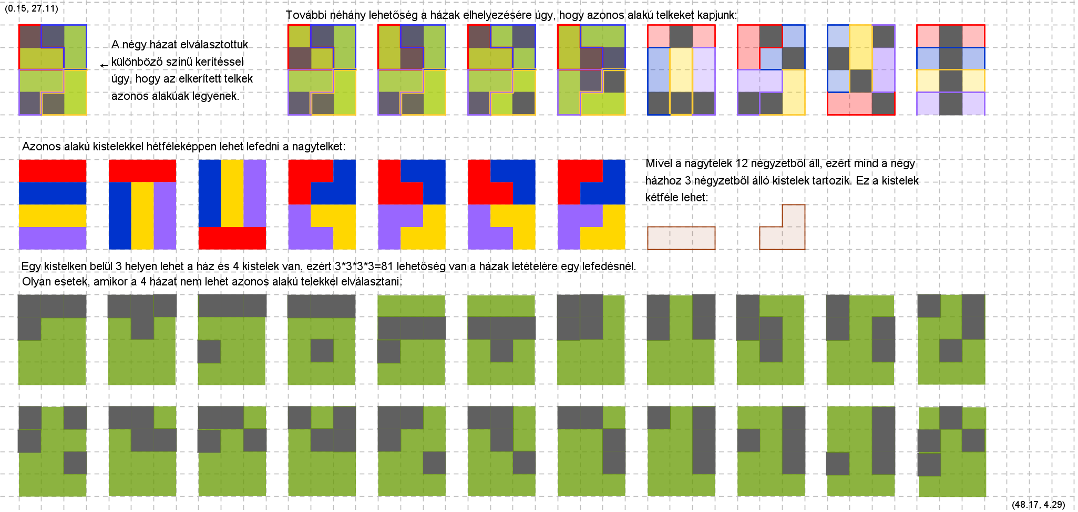

Slide 21
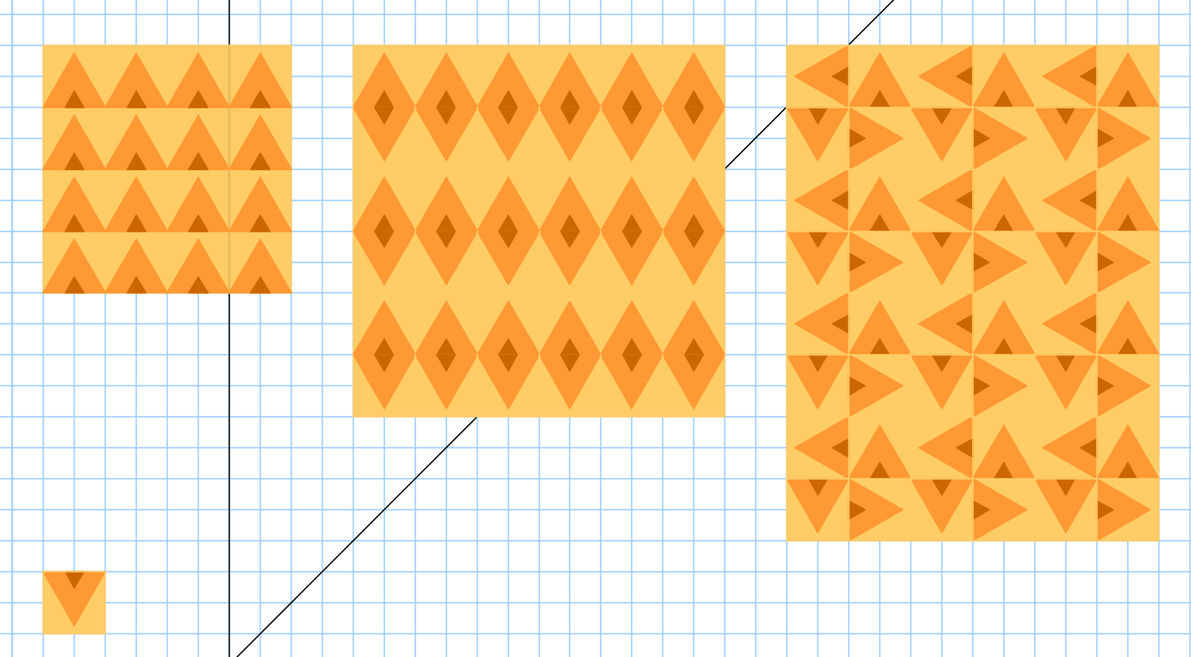
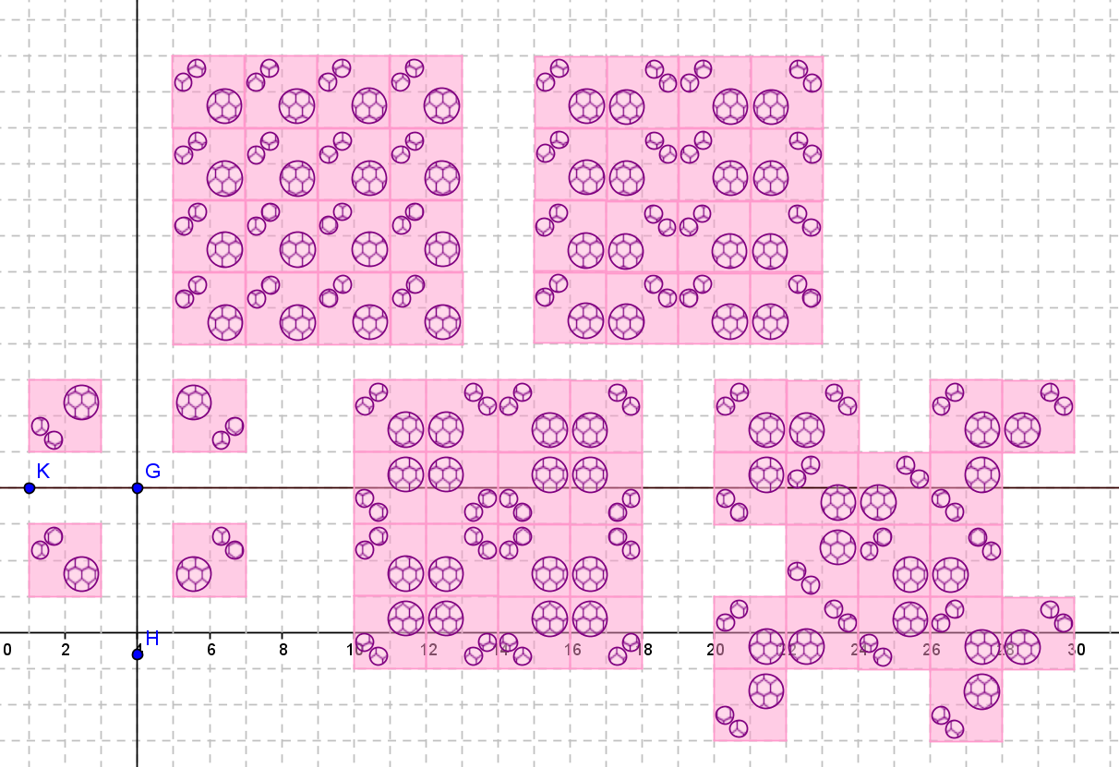

Slide 22
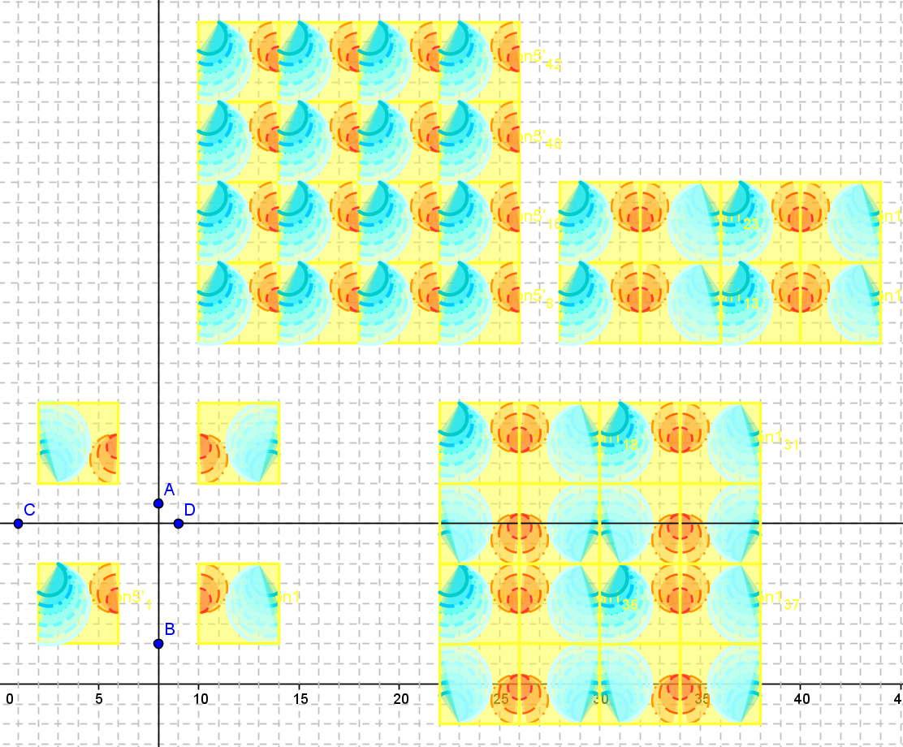

Slide 23
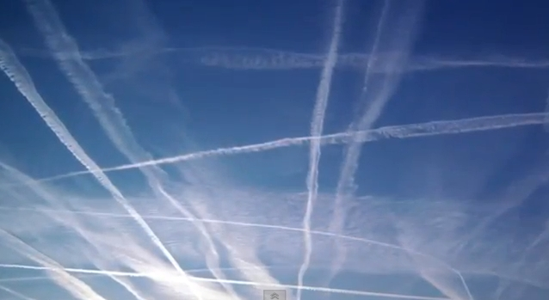
Formulation of conjectures
GeoGebra helps us in the development of conjectures
7th and 8th class students
I am sure you have already seen a plane drawing a contrail. If we look up at the sky, we can see where it was flying, for a long time . In GeoGebra there is also a similar feature of the moving shapes, this is the trace. If we turn it on, we can follow the path of a moving point. Carry out the necessary constructions in GeoGebra and explain the obtained result with the help of the trace.

Slide 24
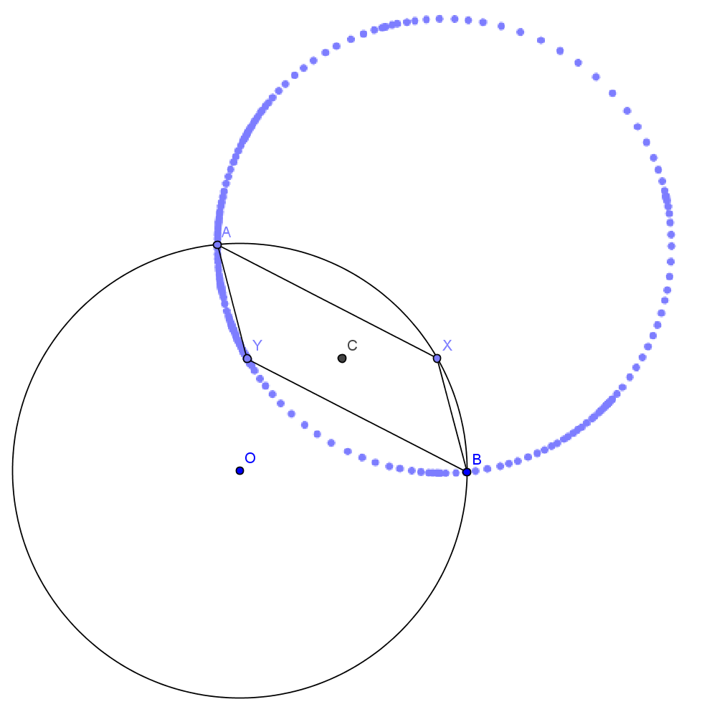
Select two points, A and B on a circle! Let’s take another point on the circle, X, which runs along the circle! Construct a point Y in every situation, so that Y will be the vertex opposite X in the AXBY parallelogram! What shape does point Y run through? Why?
Error group: Construction and cronicle run parallel. First we can see the incorrect solution, after that the correction and during the correction the conversation.
Error_7_8(1).ggb

Slide 25
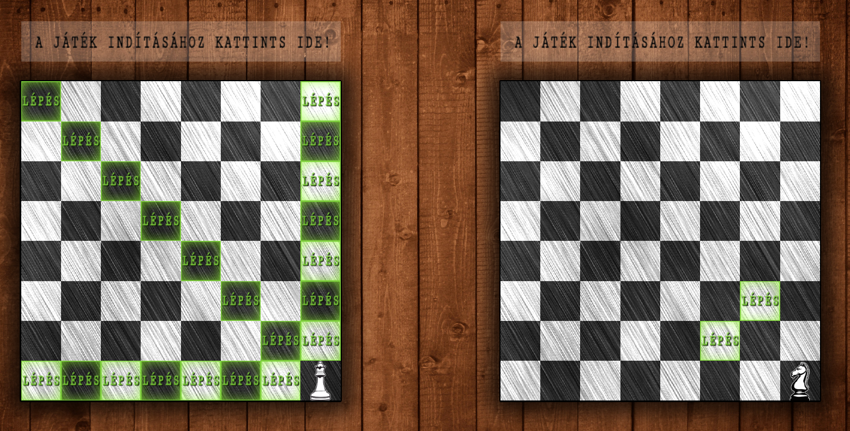
Thank you for your attention!

